Slide 1
CS-GY 6313 B: Information Visualization
9/19/2024

Slide 2
Logistics
Assignment 1 today
Join the class Slack: Link on syllabus
LaTeX tip: If homebrew is installed, instead of the massive 6gb install of all tex stuff, brew has this cask: https://formulae.brew.sh/cask/basictex that installs the basic features that regular users need.

Slide 3
Visual Perception

Slide 4
The Perceptual Process
Sensation: physical stimulation
Perception: interpretation of the sensory information

Slide 5
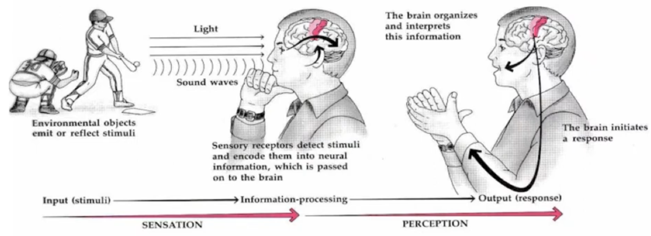
The Perceptual Process

Slide 6
Sensation vs perception
SENSATION: initial steps in the perceptual process, whereby physical features of the environment are converted into electrochemical signals that are sent to the brain for processing
SENSES: Physiological functions for converting particular environmental features into electrochemical signals
PERCEPTION: Later steps in the perceptual process, whereby the initial sensory signals are used to represent objects and events so they can be identified, stored in memory, and used in thought and action
REPRESENTATION: information in the mind and brain used to identify objects and events, to store them in memory, and to support thought and action

Slide 7
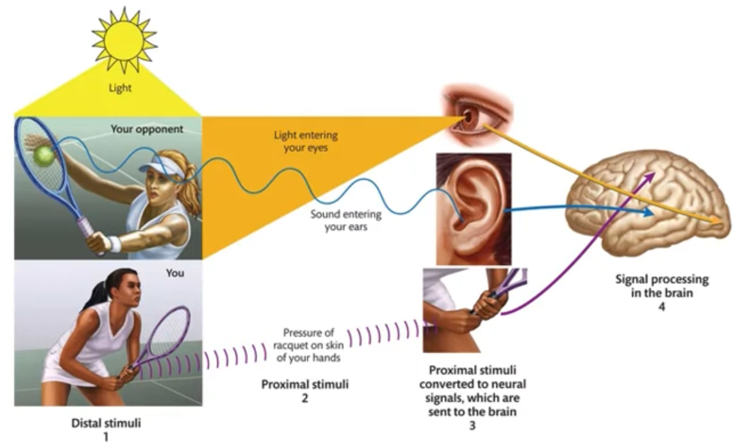
Stimuli
Stimuli: Objects and events that are perceived (distal stimuli) and the physical phenomena they produce
Distal stimulus: Perceived object or event in the world
Proximal stimulus: Physical phenomenon evoked in you by that distal stimulus

Slide 8
Principles of perception
Bottom-up processing: Information contained in neural signals from receptors
Top-down processing: Observer’s knowledge, expectations, and goals affect their perception of stimuli
An idea from 1866 (von Helmholtz)
Helps us explain things like optical illusions
https://www.youtube.com/watch?v=bgTbvyKyPCE
https://youtu.be/2k8fHR9jKVM?t=4

Slide 9

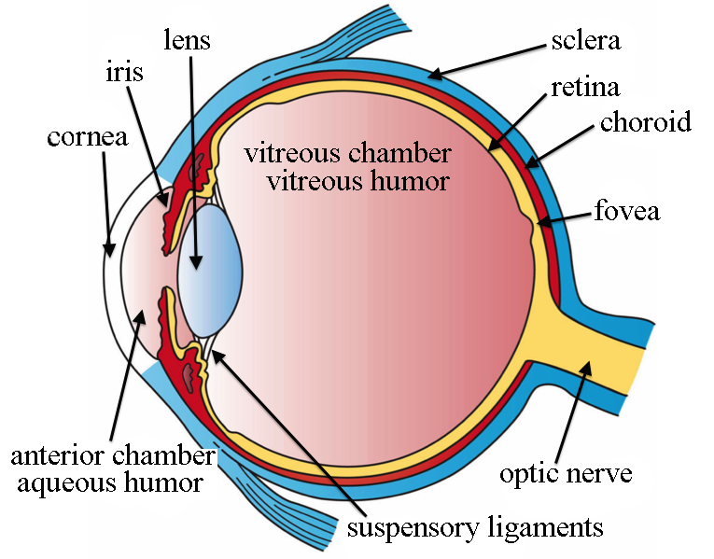
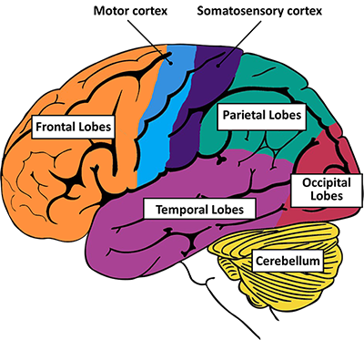
Perception-action loop
Sensation
Light + optics
Transduction
Perception + cognition
Action

Slide 10
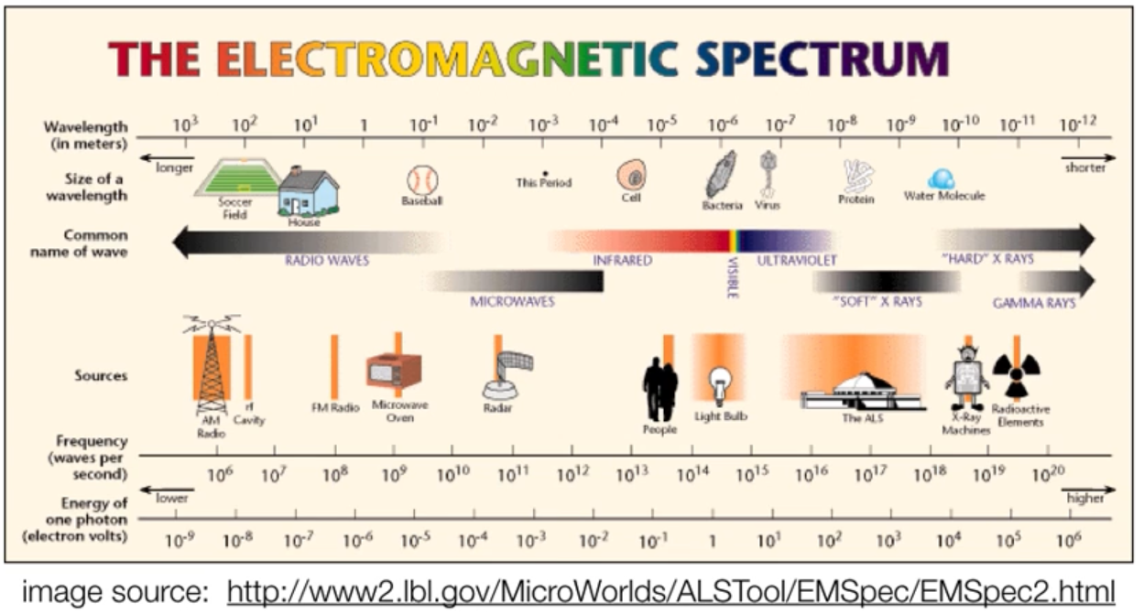
Light & Optics
Electromagnetic Spectrum: Entire range of wavelengths of electromagnetic radiation
Notes:
We only see that tiny rainbow range above the lightbulb

Slide 11
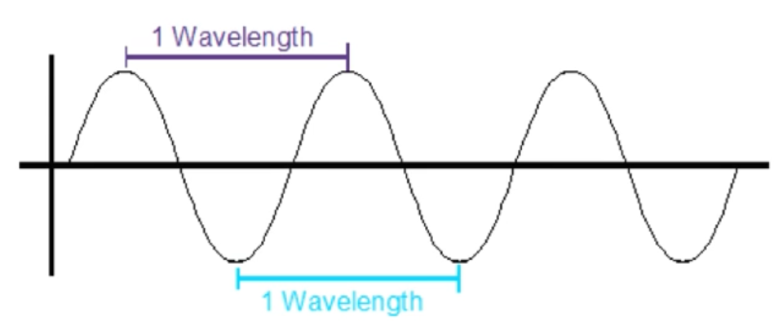
What is light?
Both a wave and a particle
We care mostly about the wave properties
Wavelength is a property of electromagnetic radiation
Distance between two successive peaks of waves
Different types of electromagnetic radiation are defined by their differences in wavelengths

Slide 12
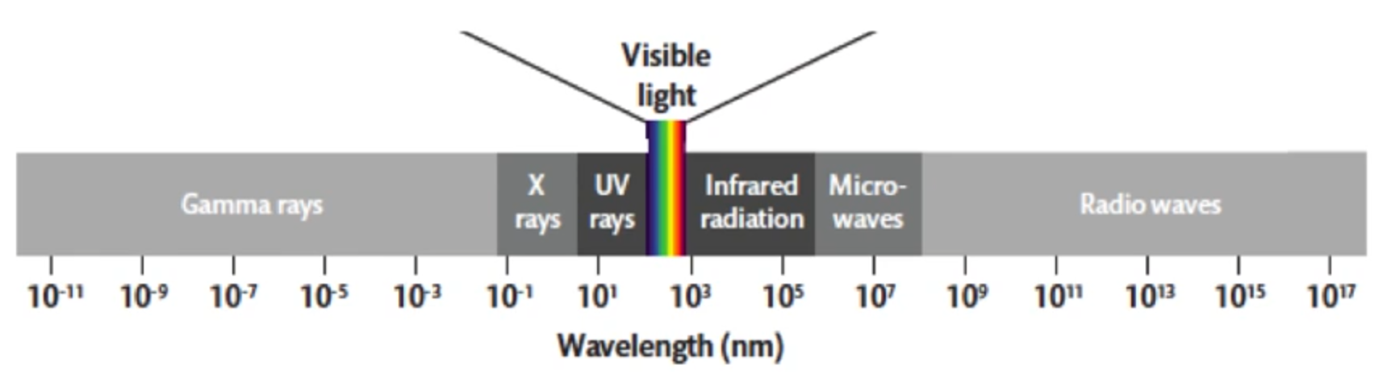
What is light?
Light is the small slice of wavelengths in the middle of the spectrum (370 nm to ~730 nm)
In this range, differences in wavelength are perceived as differences in color

Slide 13
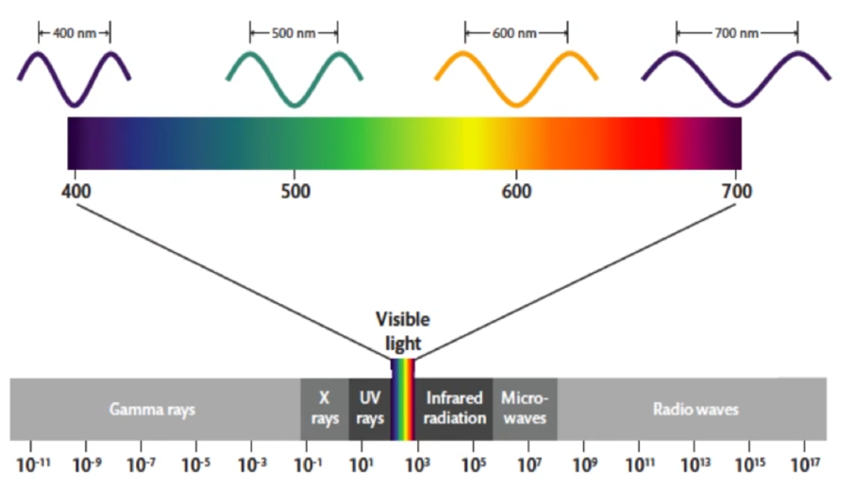
What is light?
Color of an object is the wavelengths of light that are reflected to the observer

Slide 14
The Eye

Slide 15
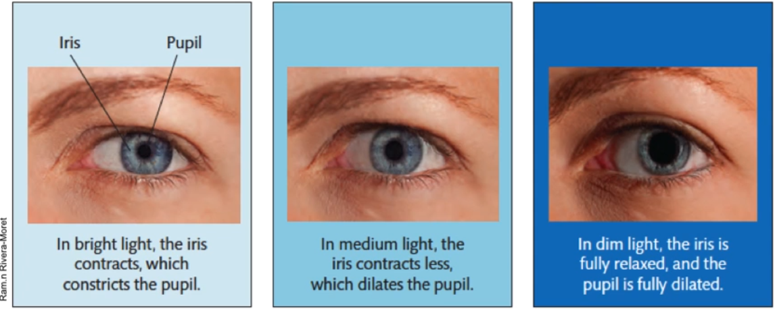
Iris and pupil

Slide 16
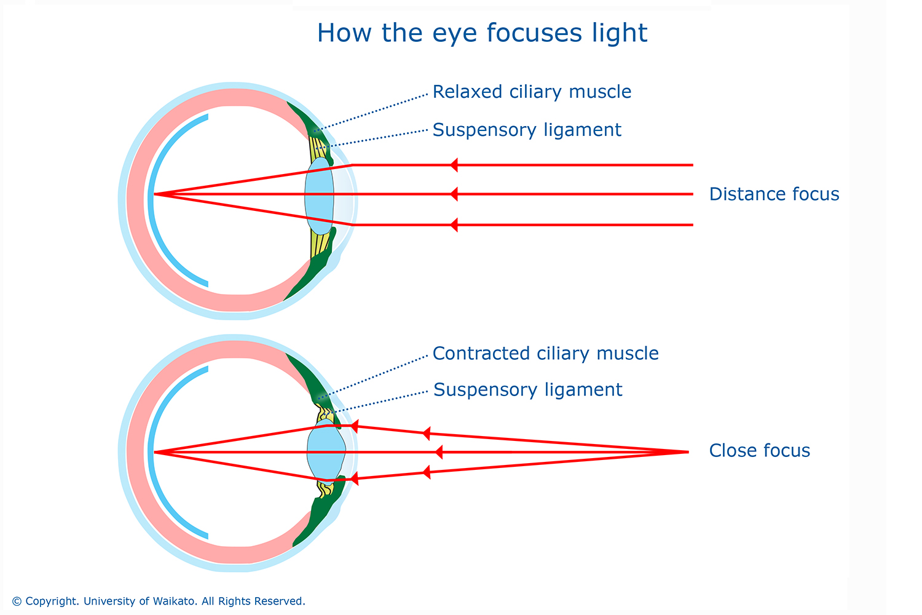
Lens

Slide 17
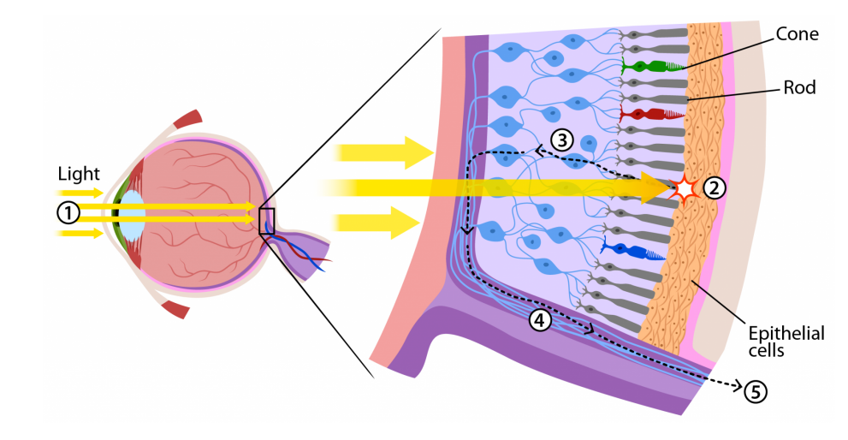
Retina

Slide 18
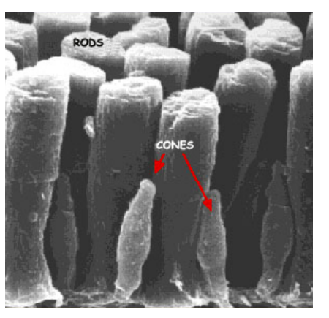
Retina: photoreceptors
Rods: Sensitive to light levels, good for low light vision, can’t see color
120 million
Only one type
Cones: Only activate at high light levels, responsible for color vision and fine details
5-6 million
3 types of cones:
~60% L(ong)
~30% M(edium)
~10% S(hort)

Slide 19
Retina: optic nerve
Blind spot!
Why don’t we see a hole in our vision?

Slide 20
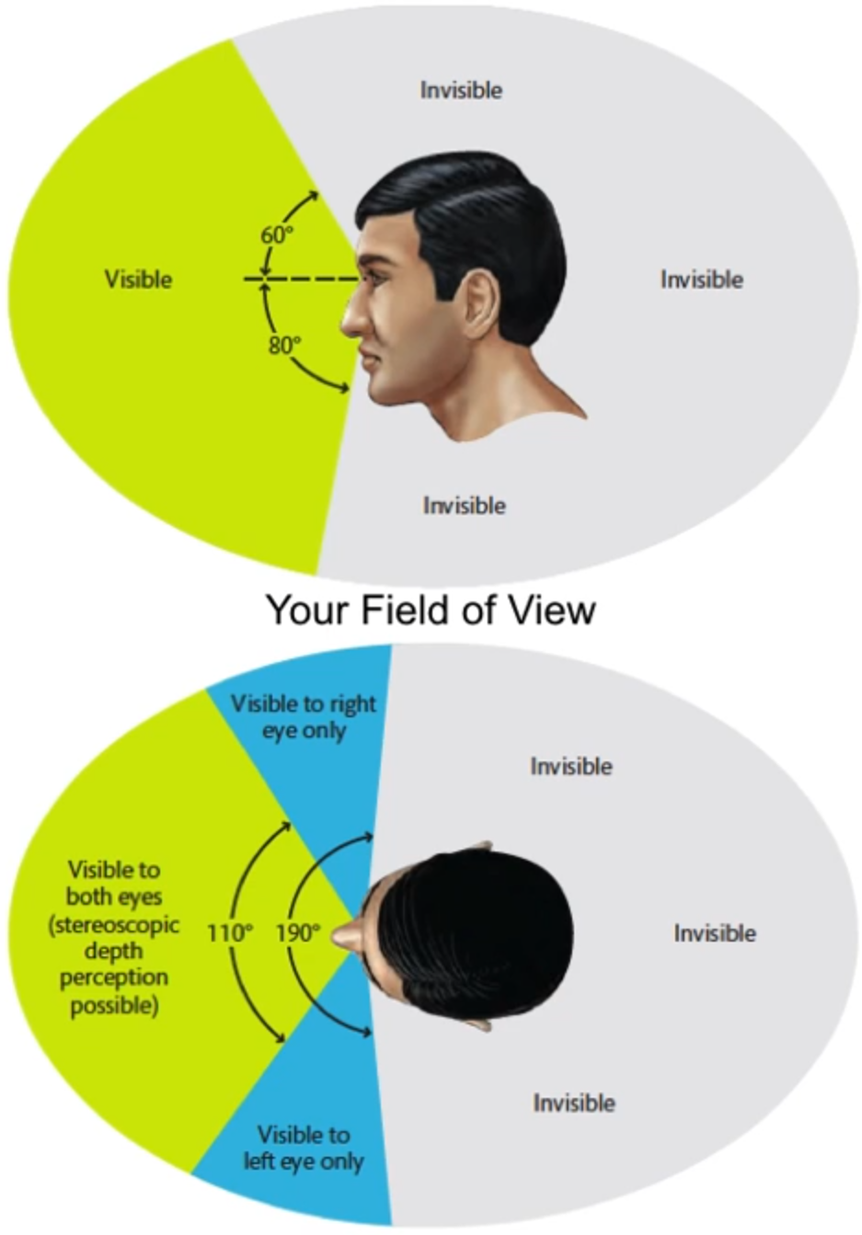
Field of view (FoV)
The range of space around you that you can see
Depends on the position of eyes
Humans: eyes in front of head
Good for navigating
Good for depth perception (overlapping FoV)
Guides the movement of our hands and fingers

Slide 21
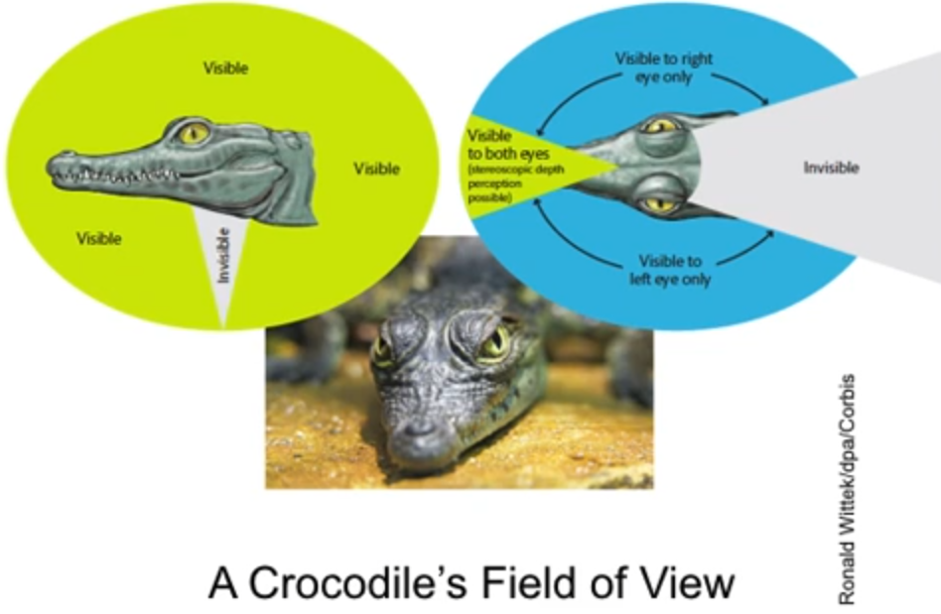
Field of view (FoV)
Crocodiles: eyes on side of head
Good for finding food
Most predators’ eyes are on the front of their head → good depth perception
Crocodiles are ambush predators!
Most preys’ eyes are placed laterally on head → easier to see nearby predators

Slide 22
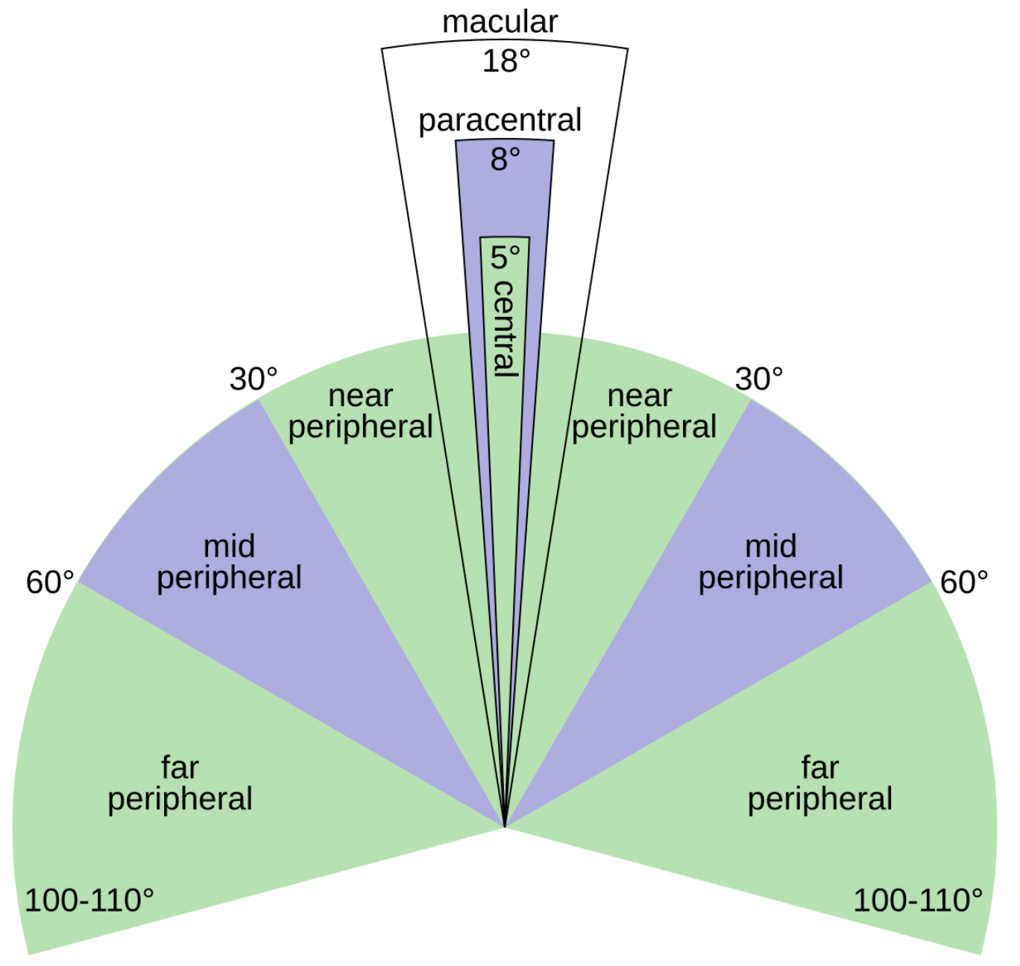
Field of view (FoV)
Foveal vision = the center of your retina/field of view
Very high visual acuity
Peripheral vision = not foveal vision
Generally speaking, visual performance changes as a function of eccentricity
Peripheral vision is usually “worse” for most tasks

Slide 23
Peripheral vision: crowding
KXK
+
KXK

Slide 24
Peripheral vision: crowding
KXK
+
XVX

Slide 25
Peripheral vision: crowding
KXK
+
XVX

Slide 26
Peripheral vision: crowding
X
KVK
X
+
XVX
+
XVX

Slide 27
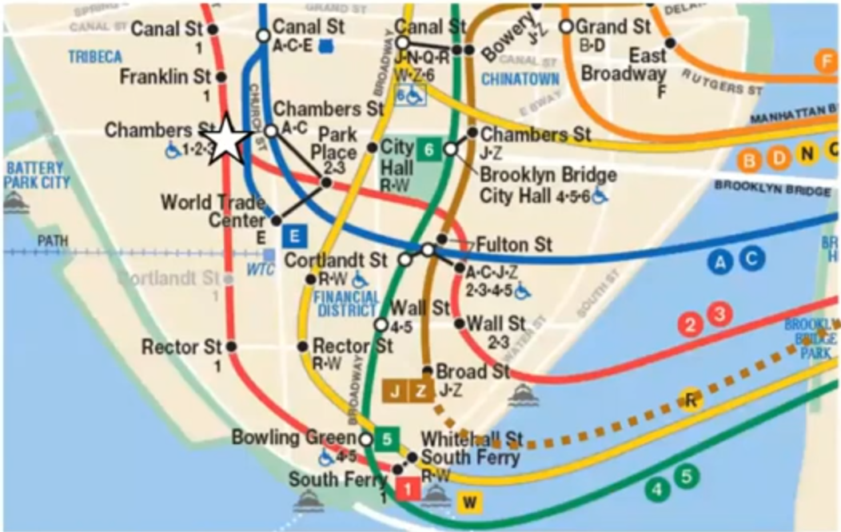
Peripheral vision: crowding

Slide 28
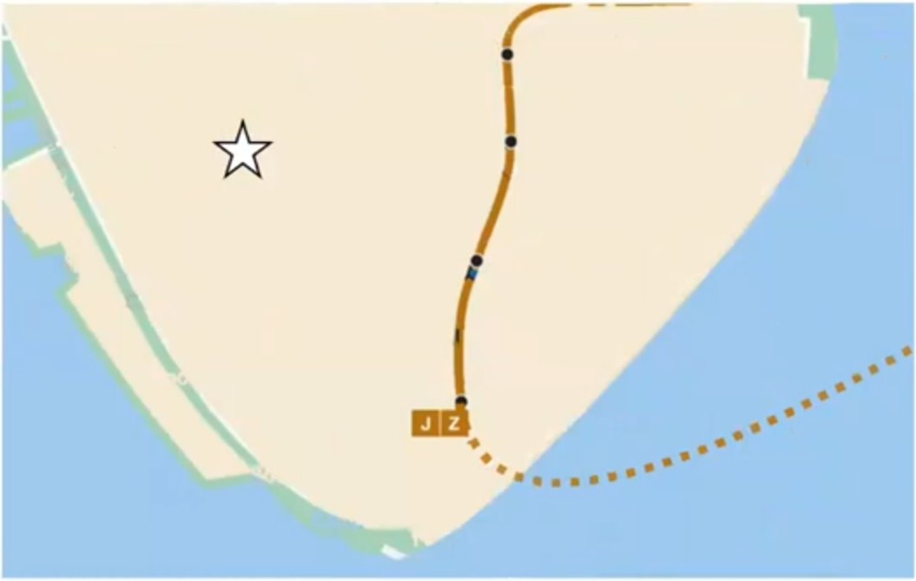
Peripheral vision: crowding

Slide 29
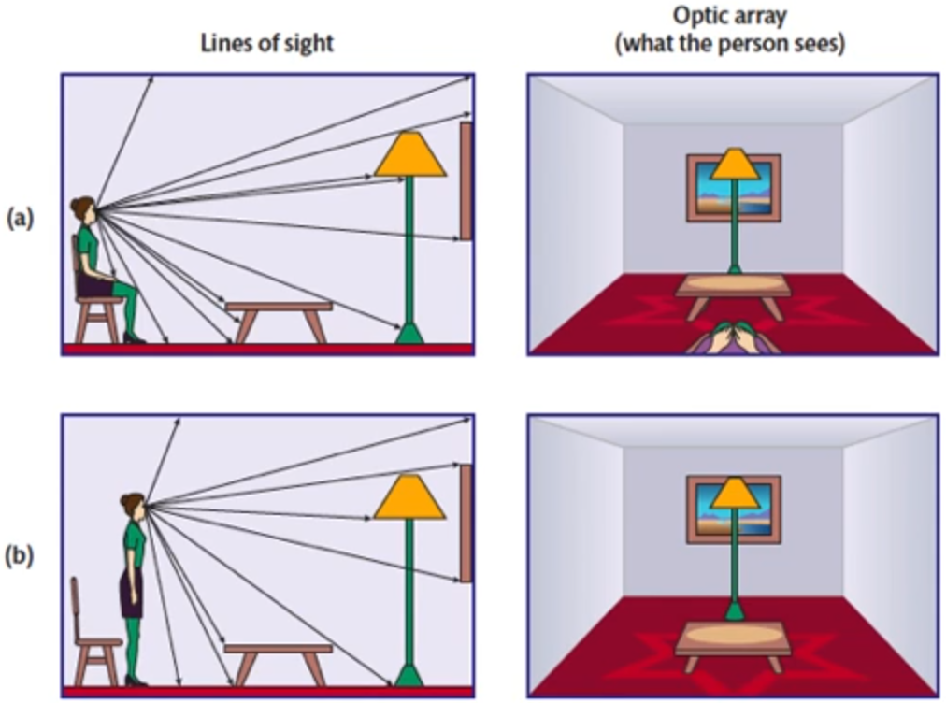
Optic array
Pattern of light on the retina

Slide 30
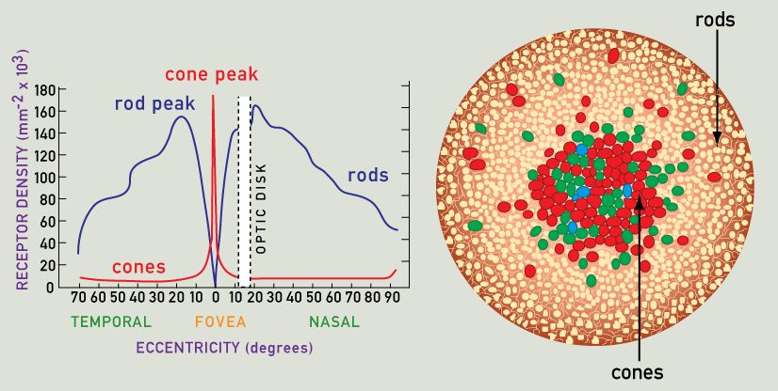
Density of photoreceptors
Density of cones in the fovea is very high
Falls off sharply
Not many rods in the fovea
More rods outside of the fovea, still falls off

Slide 31
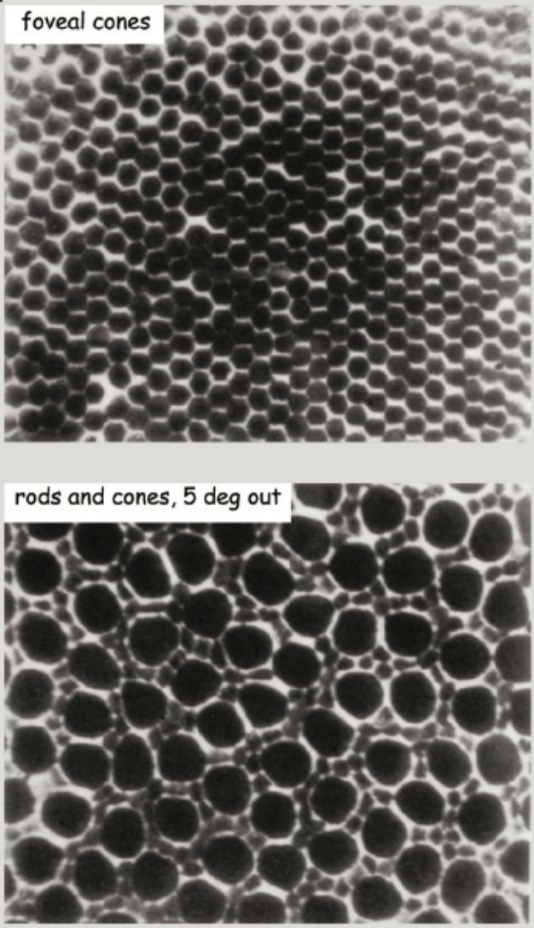
Density of photoreceptors
Density of cones in the fovea is very high
Falls off sharply
Not many rods in the fovea
More rods outside of the fovea, still falls off

Slide 32
Density of photoreceptors
Rods are still useful!
Comprise the vast majority of your retina → basically always in use
Good for night vision and motion perception

Slide 33
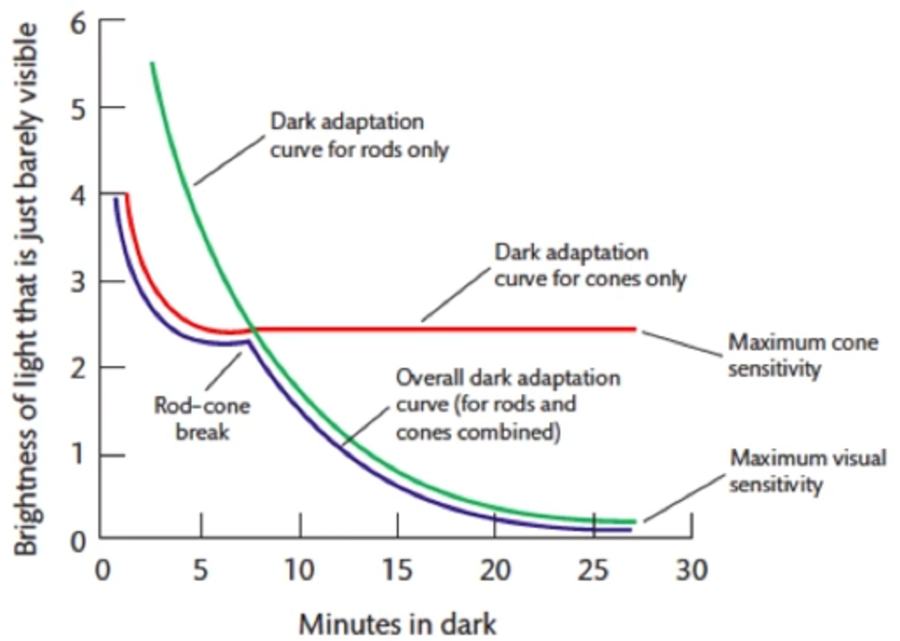
Dark adaptation
Light adaptation (dark to light):
One minute of adaptation → doing pretty well
Whole process takes about 10 minutes to become fully light-adapted
Dark adaptation (light to dark):
Much slower process
Whole process takes up to 30 minutes to become fully dark-adapted

Slide 34
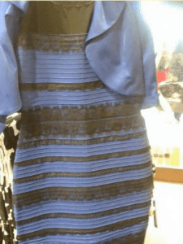
Color
Objects don’t have color themselves
Color is the perception of reflected light
Different organisms do not necessarily see objects as the same color

Slide 35
Color
Different colors = different wavelengths of light
Heterochromatic vs monochromatic light
Heterochromatic: wide range of different wavelengths (e.g. sunlight)
Monochromatic: single wavelengths (e.g. incandescent bulb)
Different objects have different reflectances
Black paper reflects <10% of light, white paper reflects >80% of light

Slide 36
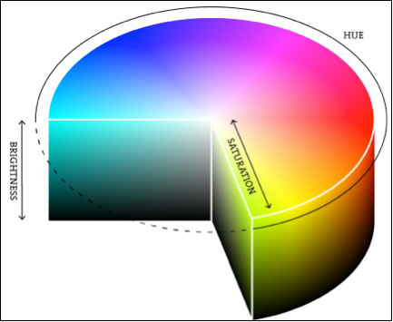
Color: Hue, Saturation, and Brightness
Physical components of light and surfaces determine the wavelength of light that enters the eye → produces a subjective experience of color
Hue: usually referred to as “color”; perceptual characteristic most closely associated with the wavelength
Saturation: vividness/richness of a hue
Brightness: amount of light

Slide 37
Color mixing
Additive color mixture: mixture of different-colored lights. The perceived color is the result of adding together all wavelengths in all the lights in the mixture
Primary colors: red, green, blue
Subtractive color mixture: mixture of different colored substances. The perceived color is due to the mixed substances absorbing different wavelengths of light, changing the final reflected light
Primary colors: red, yellow, blue
Cyan, magenta, yellow for printing
Complementary colors: pairs of colors that produce grey when combined in equal proportions. Opposites in the hue space
Primary colors: any 3 colors that can be combined in different proportions to produce a range of other colors. Not a single unique set

Slide 38
Color representation
Two main theories on how color is represented:
Trichromatic color representation
Opponent color representation

Slide 39
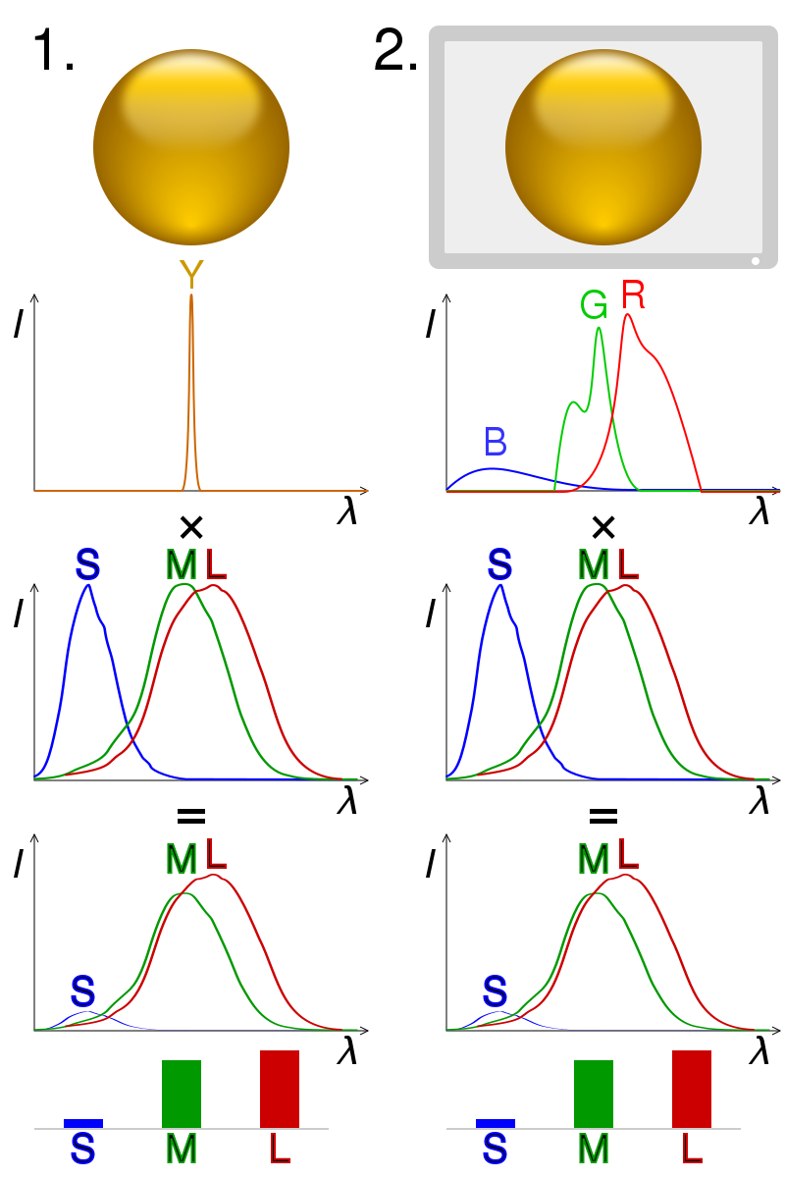
Trichromatic color representation
Three types of color photoreceptors
Metameric matching suggests 3 types of color receptors
Metamer: different objects (in our case, lights) that look the same but are made of different components

Slide 40
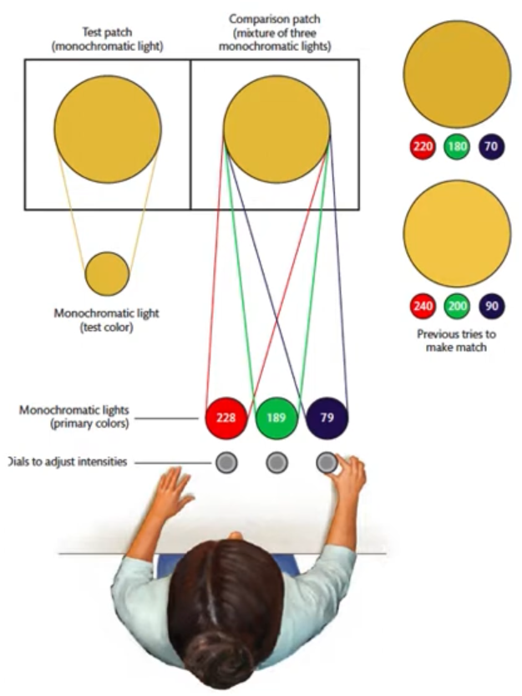
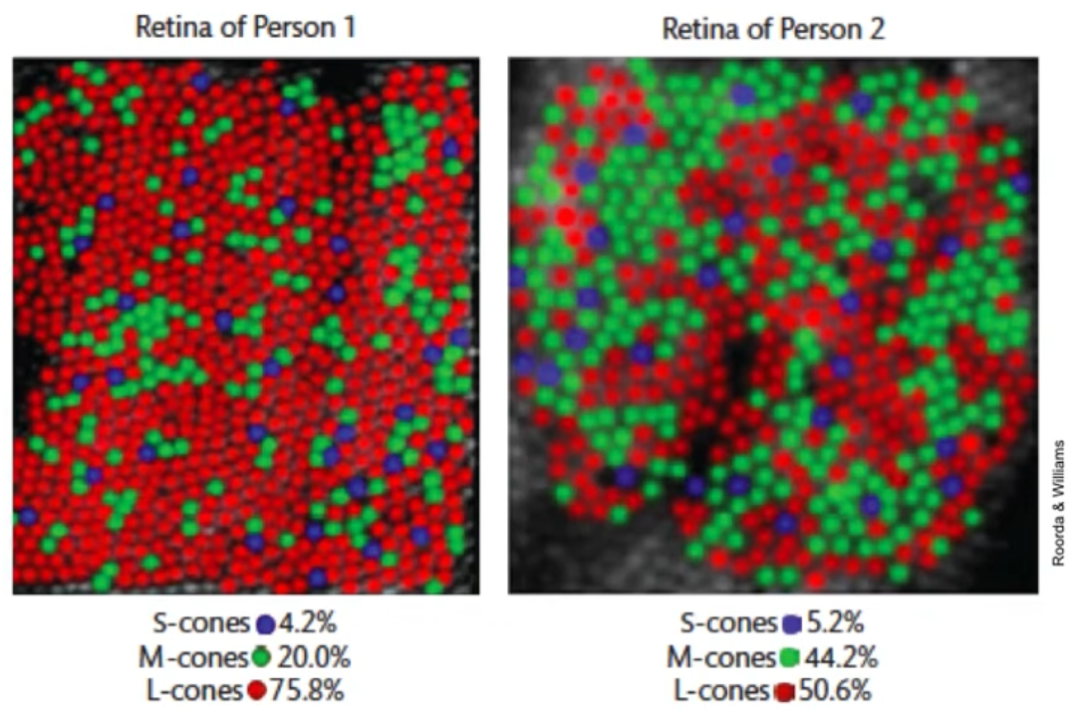
Trichromatic color representation
Participants adjusted intensities of 3 monochromatic lights until their mixture matched a given test patch
Showed support of the 3 types of cones before we were able to image the retina!
Try it yourself: https://elvers.us/perception/metamers/

Slide 41
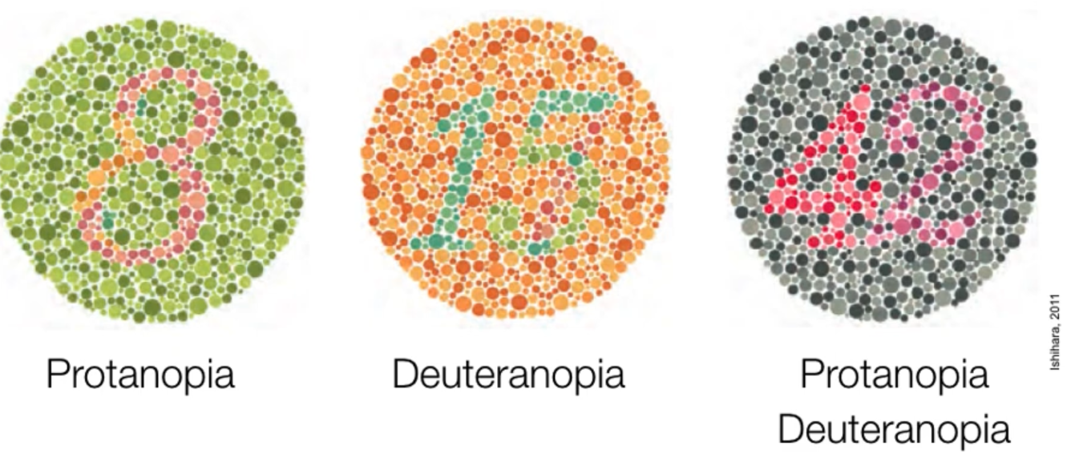
Color vision deficiencies
Most people with color vision deficiencies are not completely blind to certain wavelengths, just less sensitivity
Monochromacy: person only has rods or only rods + 1 type of cone
Totally color blind, sees everything as shades of gray
Dichromacy:
Protanopia: person has M- and S-cones, but lacks L-cones. 1% of males, 0.02% of females
Deuteranopia: person has L- and S-cones, but lacks M-cones. 1% of males, 0.01% of females
Tritanopia: person has L- and M-cones, but lacks S-cones. 0.002 % of males and females
Simulate them: https://www.color-blindness.com/coblis-color-blindness-simulator/

Slide 42

Opponent color representation
Most humans have 3 (some have 4) types of cones for red, green, and blue wavelengths
Humans act as if there are 4 primaries
Evidence: color sorting tasks, after images, hue cancellation tasks, neuroscience

Slide 43
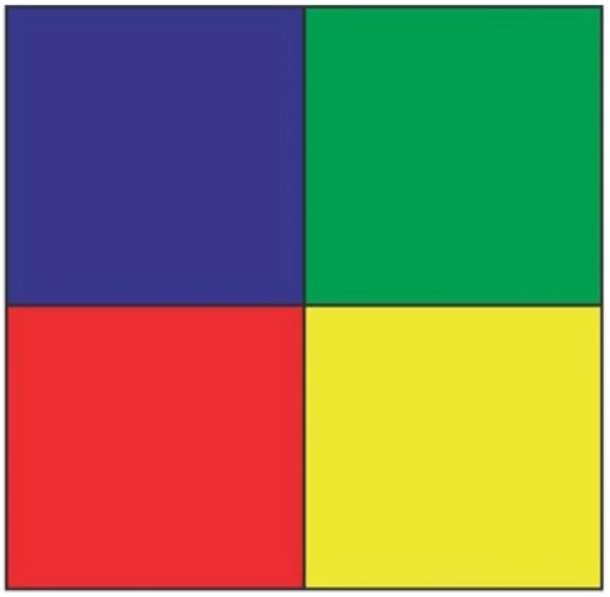

Slide 44


Slide 45
Opponent color representation
Color afterimages: a result of photopigment bleaching, known as chromatic adaptation
Hue cancellation: you can eliminate the perception of a color in a light by adding light of the complementary color

Slide 46
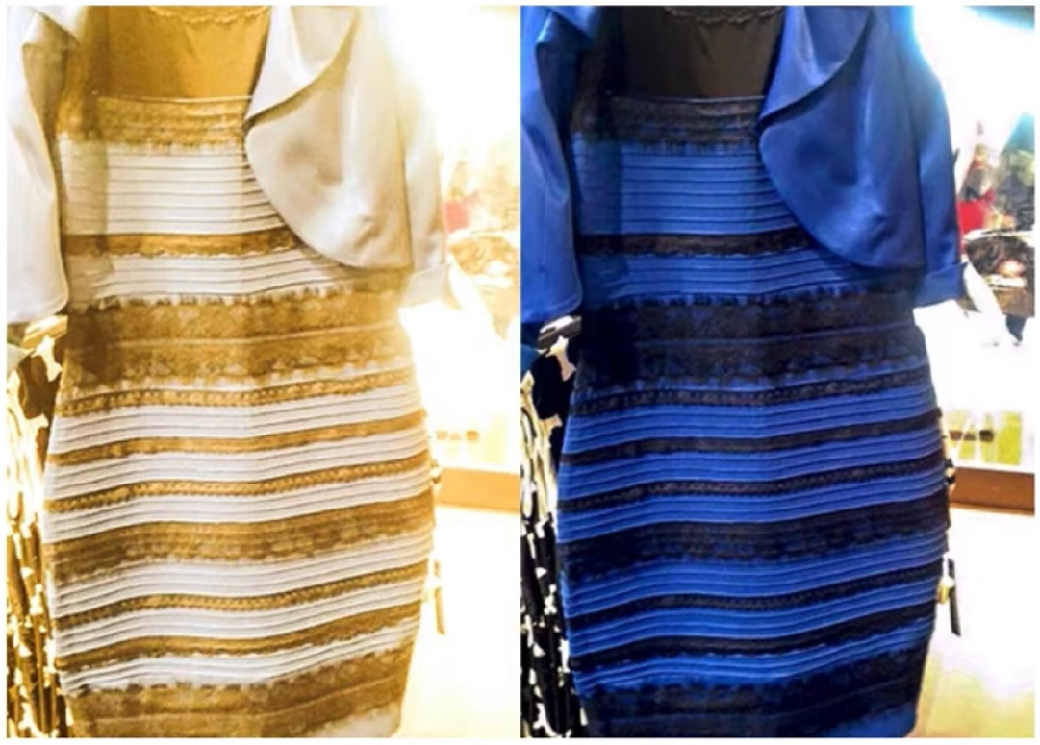
Color constancy
Color is perceived as consistent under different types of light as long as enough wavelengths are available
Visual system estimates amount of each wavelength reflected from all surfaces on average
Tends to operate via the same concept of color adaptation
Color constancy can fail!
Fails if the illuminating light consists of only a narrow range of wavelengths
Fails if just one surface is seen against a black/empty background

Slide 47
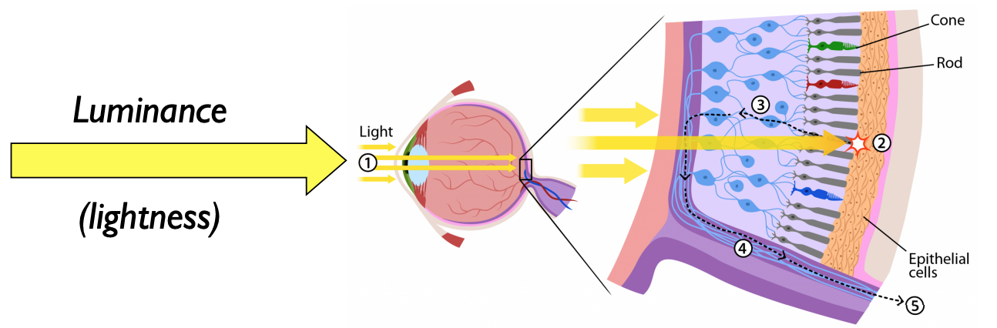
Luminance
Lightness = the perceived intensity of reflected light (reflectance) from a surface
Brightness = the perceived intensity of emitted light
Credit: Prof. Michelle Borkin

Slide 48
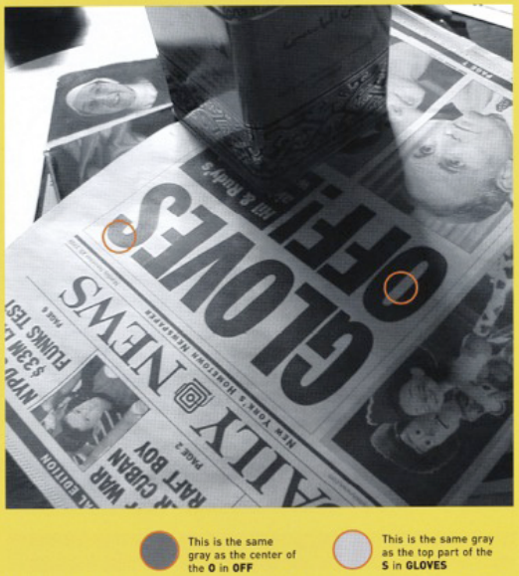
Color: lightness constancy
Lightness constancy refers to our ability to perceive the relative reflectance of objects despite changes in illumination.
Credit: Prof. Michelle Borkin

Slide 49
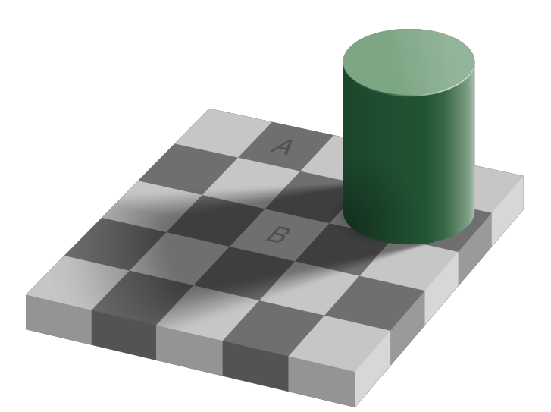
Color: lightness constancy

Slide 50
Color: lightness constancy

Slide 51
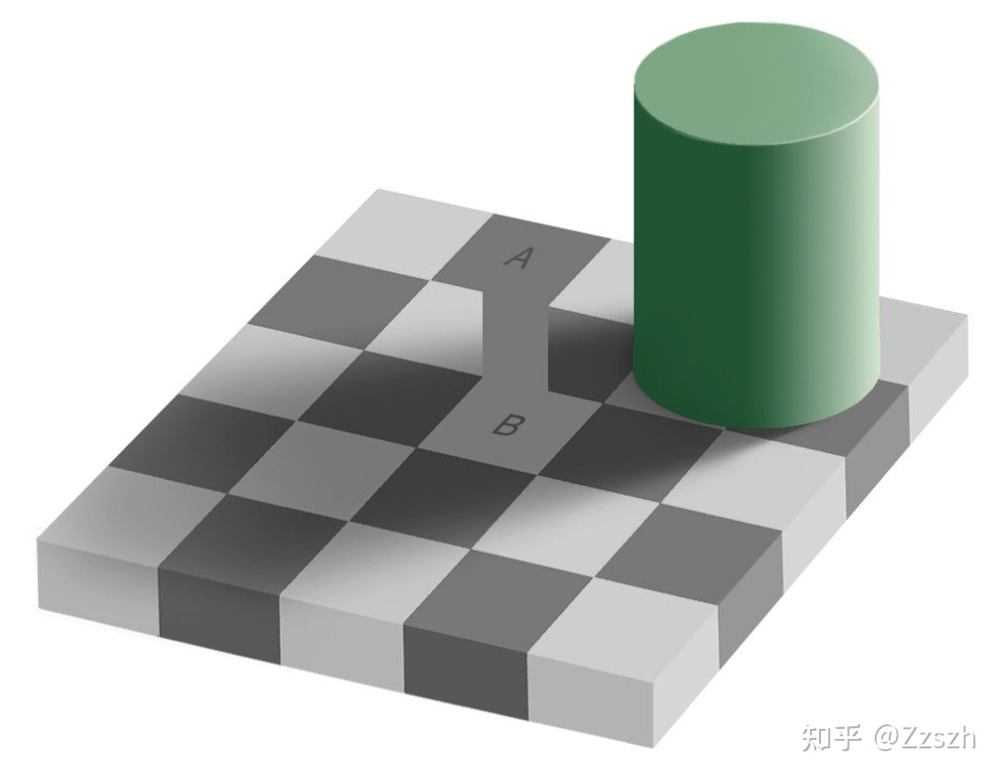
Color: lightness constancy

Slide 52
Color: lightness constancy
Ratio principle with a two-part anchoring rule:
In any given scene, the part that reflects the most light is perceived as white, and every other region is perceived in relation to that anchor point
If the scene has different regions under different amounts of illumination, the visual system applies the anchoring rule separately in each illumination zone
https://www.youtube.com/watch?v=TVUrHf2kcUM

Slide 53

Color: lightness constancy

Slide 54

Color: lightness constancy

Slide 55

Chromostereopsis

Slide 56
Perception-action loop
Sensation
Light + optics
Transduction
Perception + cognition
Action

Slide 57
Perception and cognition
Once the light reaches our brain, how do we interpret it?
Answer: Lots of specialized cells and pathways in the brain!

Slide 58
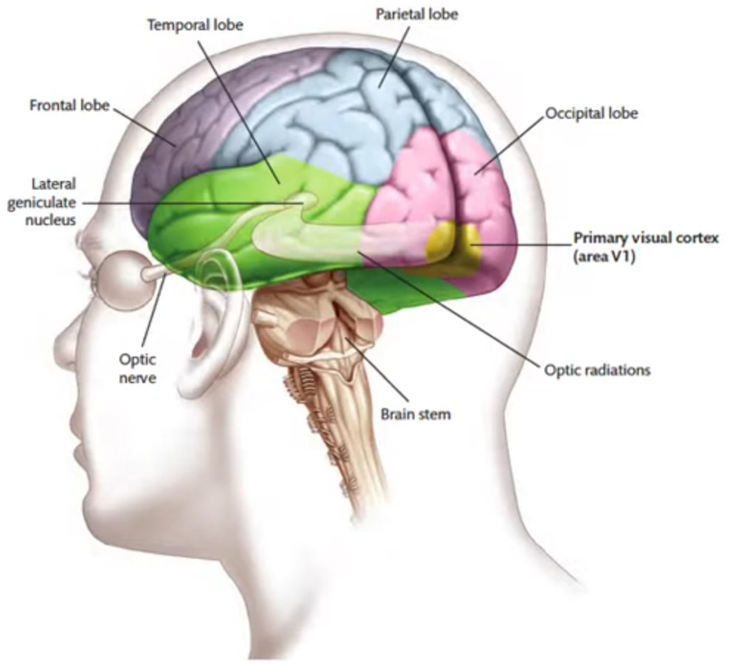
Primary visual cortex (area V1)
First stop for visual information
Further along in the brain, the more complex the information becomes
Highly organized
Rentinotopic mapping: areas of the retina map onto specific regions of V1
Cortical magnification: more important regions of the retina (fovea) take up more space in V1
Cells in V1 are stimulated by bars/edges within a narrow range of orientations
Specialized cells!
We have cats to thank: https://www.youtube.com/watch?v=IOHayh06LJ4

Slide 59
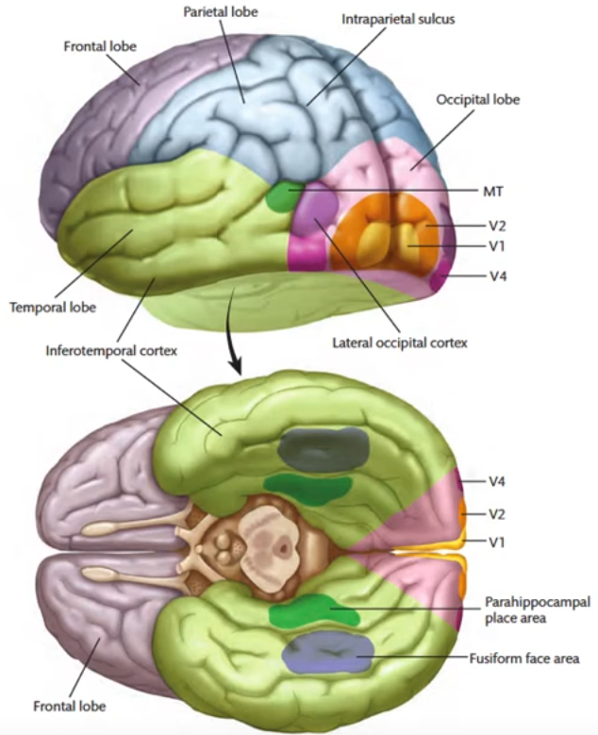
Functional areas and pathways
Functional pathways in the brain that are specialized for processing specific types of information
Neurons along different pathways are tuned to fire in response to different stimulus properties
Dorsal pathway:
Motion, location, guide actions
Ventral pathway:
Color, shape (curvature of edges)
Feature detectors (more cats): https://www.youtube.com/watch?v=RSNofraG8ZE
Notes:
Diff pathways have diff types of neurons
Diff pathways send and receive signals from diff places in the brain

Slide 60
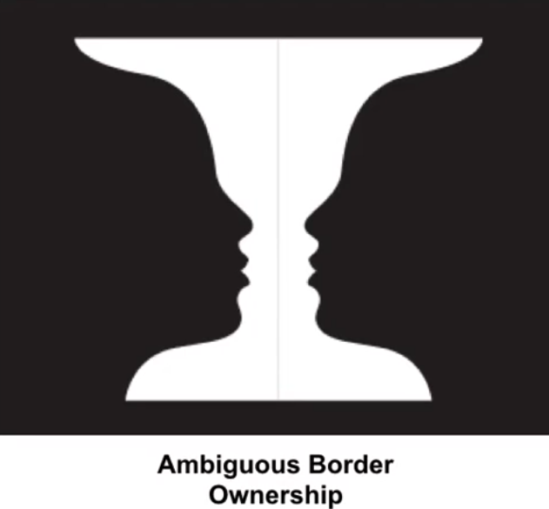
Figure-ground organization: border ownership
Which border belongs to the object we are looking at vs the background of the object?
Accomplished using edge extraction
Usually it’s clear which object ‘owns’ the border, but if it isn’t, you get an ambiguous figure

Slide 61
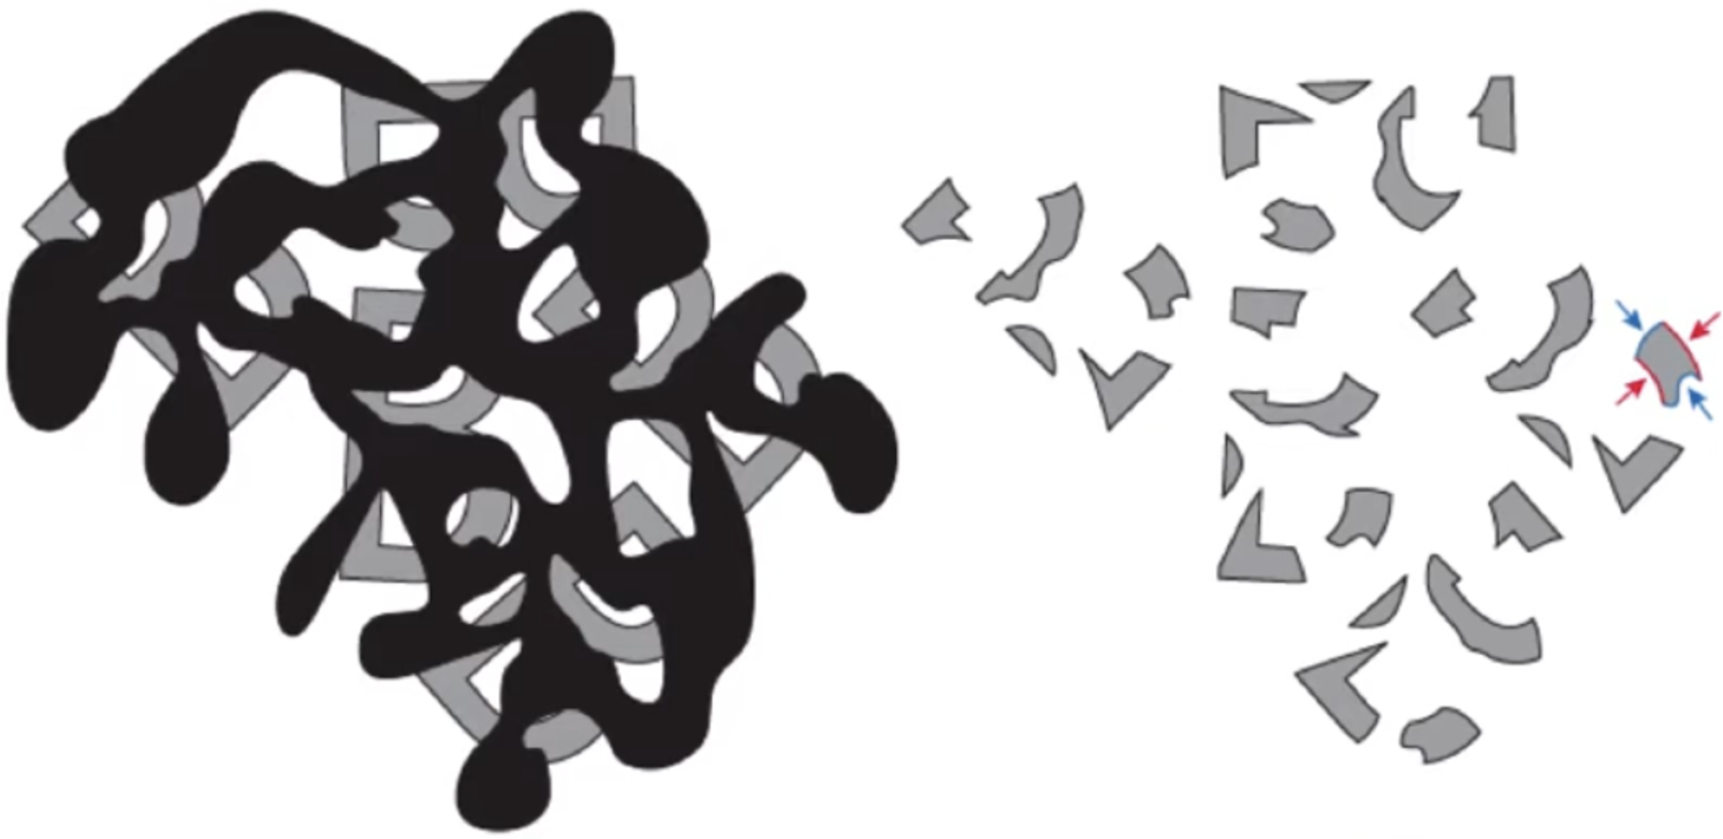
Figure-ground organization: border ownership
What do you see?

Slide 62
Figure-ground organization: border ownership
Principles:
Depth
Surroundedness
Symmetry
Convexity
Meaningfulness
Simplicity

Slide 63
Figure-ground organization: border ownership
Principles: Depth

Slide 64

Figure-ground organization: border ownership
Principles: Surroundedness
Grey on black?
Border belongs to the grey region
Black on grey?
Border belongs to the black region

Slide 65
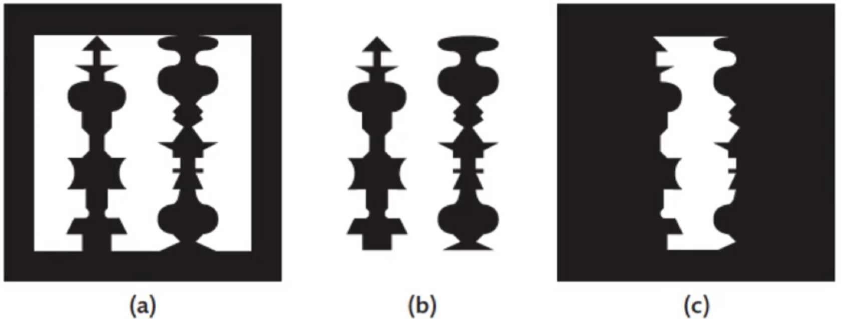
Figure-ground organization: border ownership
Principles: Symmetry
Regions with symmetry are more likely to be seen as a figure than nonsymmetric regions
Notes:
C shows only one of the 3 white regions.

Slide 66
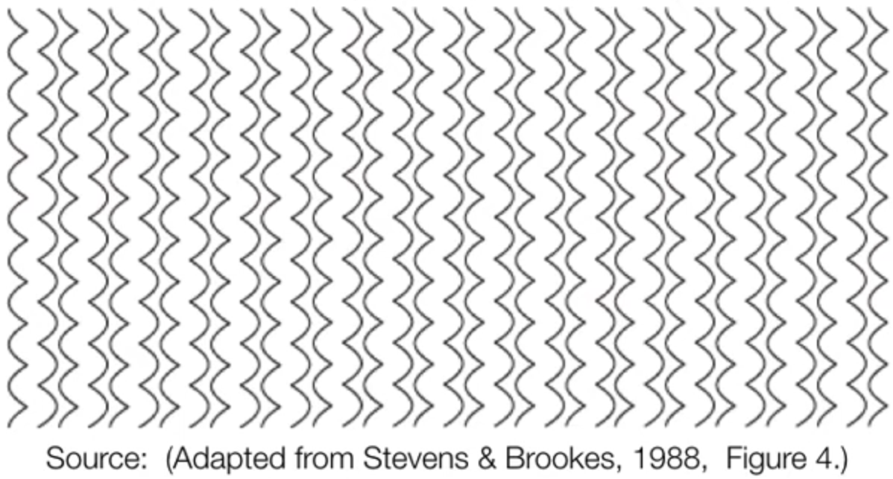
Figure-ground organization: border ownership
Principles: Convexity
Regions with convex borders are more likely to be seen as a figure than concave borders
Notes:
C shows only one of the 3 white regions.

Slide 67


Figure-ground organization: border ownership
Principles: Meaningfulness
Sometimes the semantic meaning of shapes influences border assignment
Notes:
C shows only one of the 3 white regions.

Slide 68
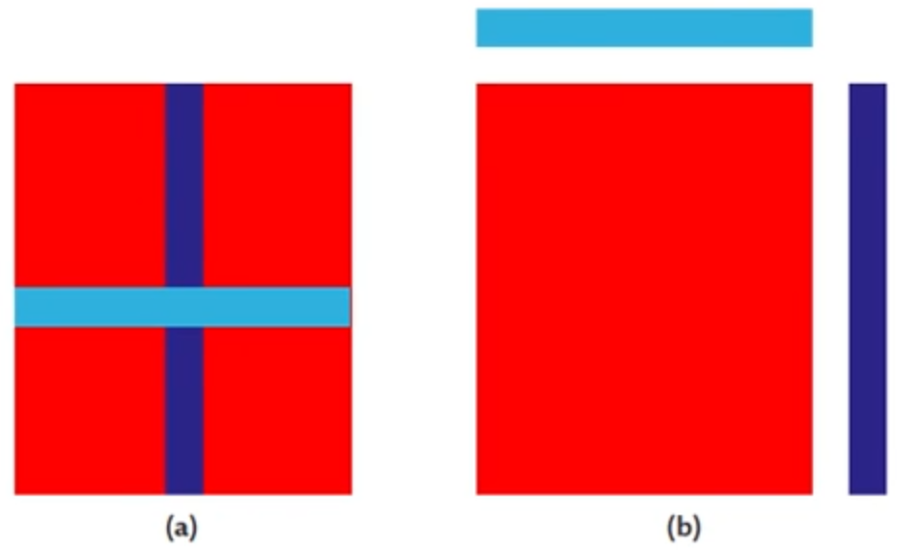
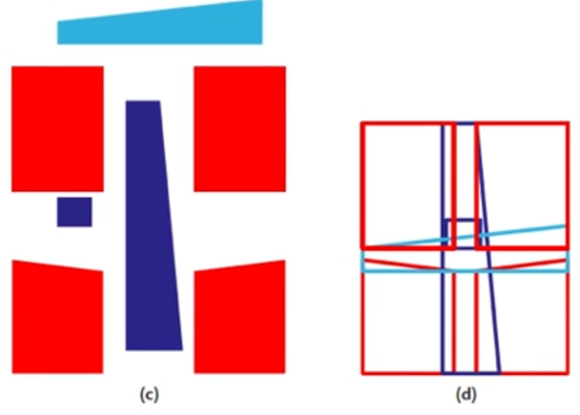
Figure-ground organization: border ownership
Principles: Simplicity
Biased towards the simplest explanation of what you see
Notes:
C shows only one of the 3 white regions.

Slide 69
Perceptual grouping
Gestalt laws:
Proximity: nearby elements are grouped more easily than far-apart elements
Similarity: similar elements are grouped together more often
Common motion: elements that move together are likely to be perceptually grouped
Symmetry and parallelism: elements that are symmetrical or parallel tend to group together
Continuity: edges that would meet if extended are perceived as a single edge

Slide 70
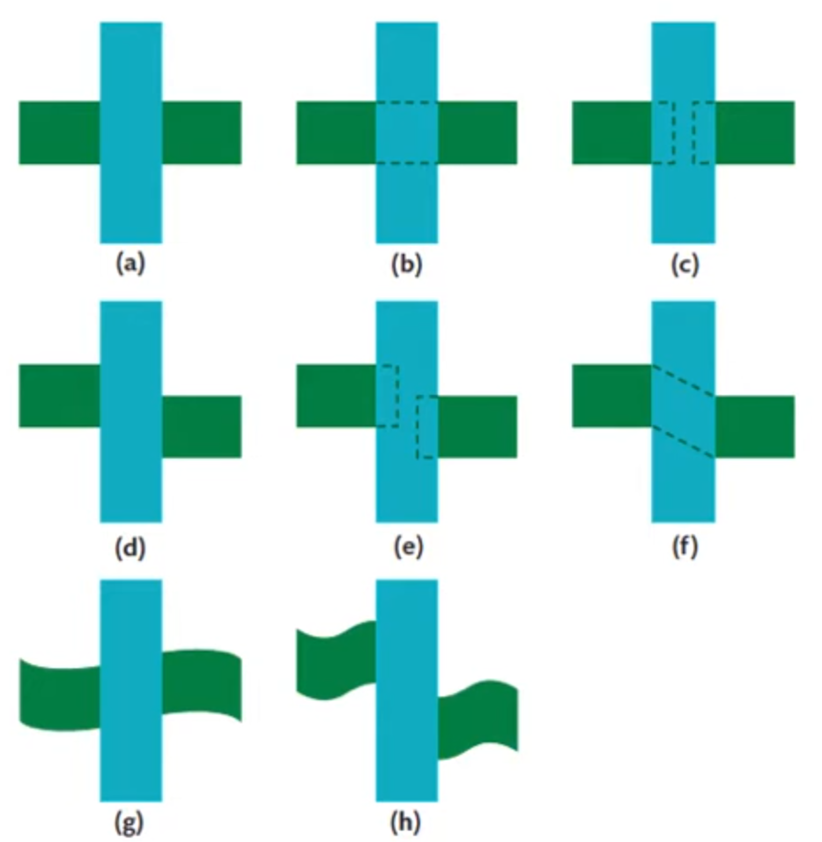
Perceptual grouping: continuity

Slide 71
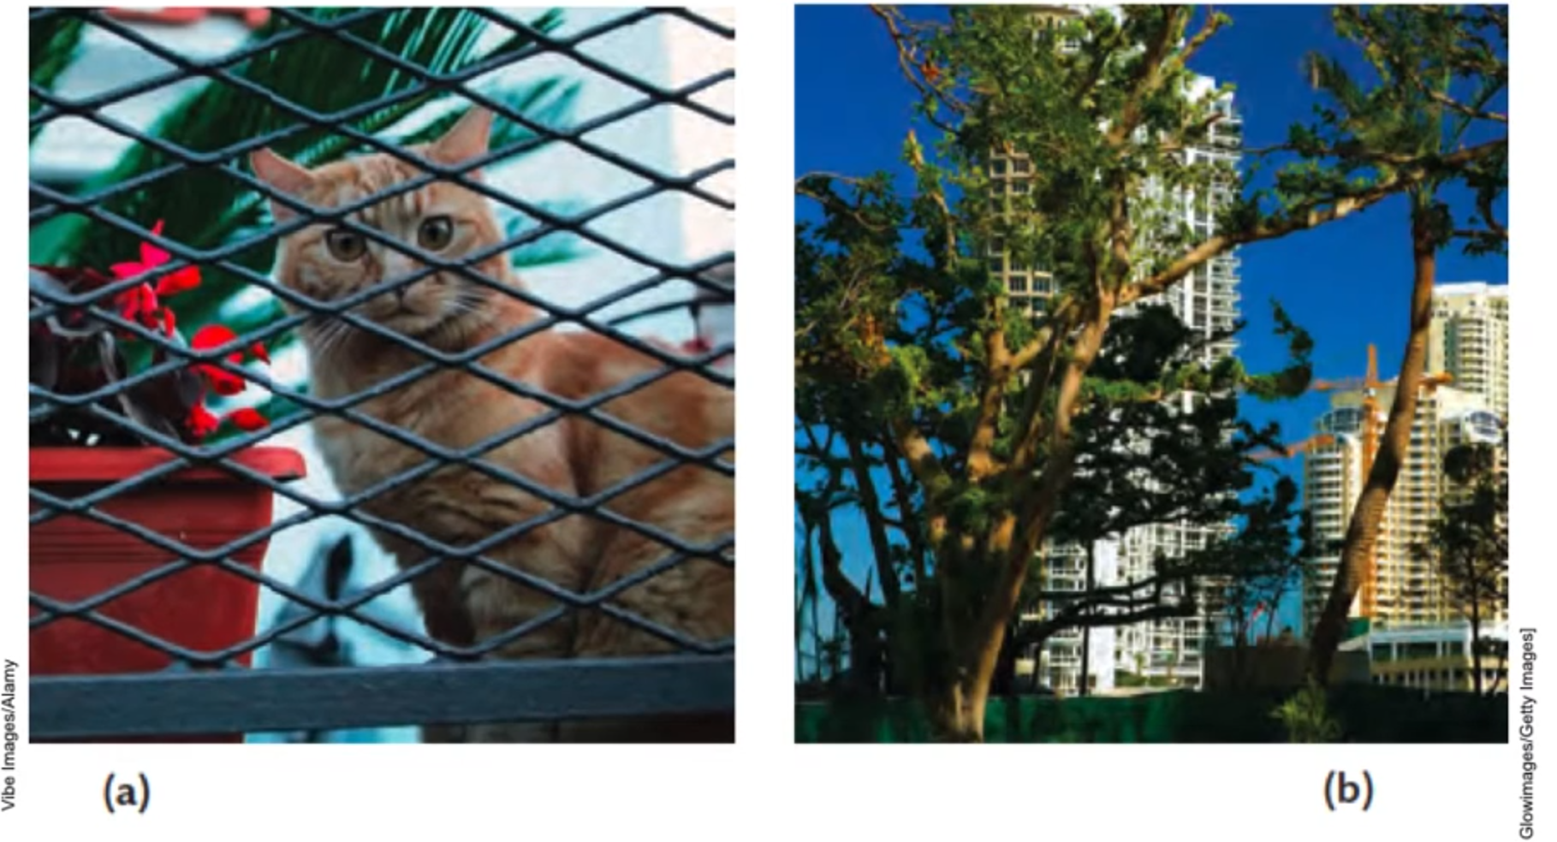
Perceptual grouping: interpolation

Slide 72
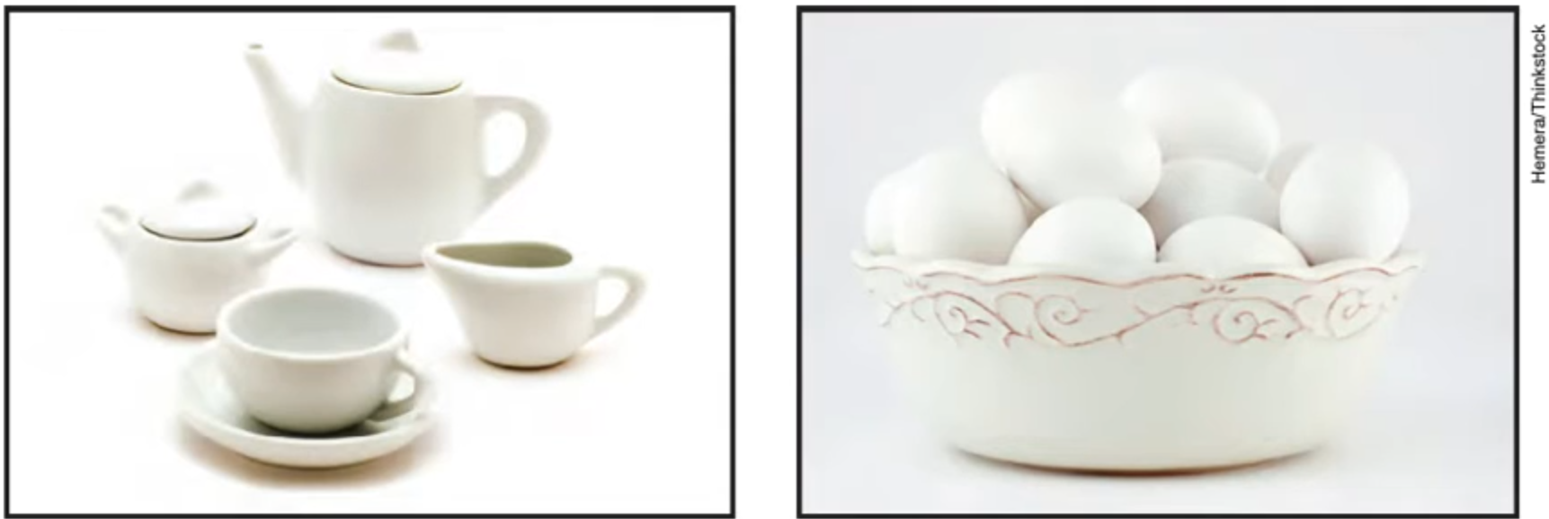
Perceptual grouping: interpolation

Slide 73
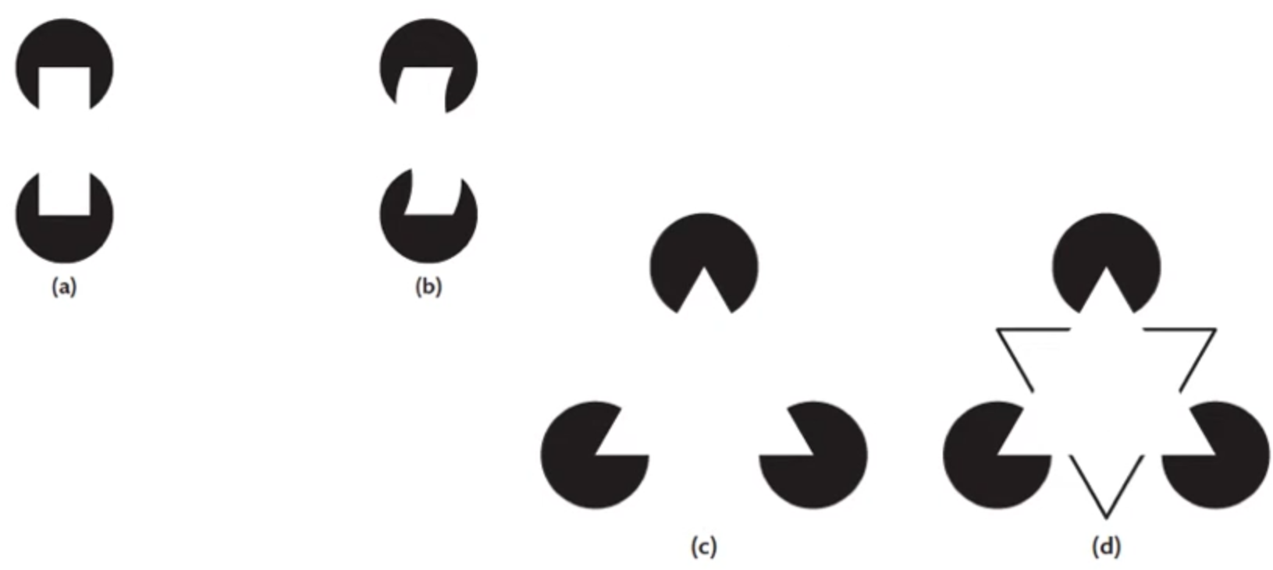
Perceptual grouping: interpolation
Two mechanisms at play:
Finding edges
Completing surfaces

Slide 74
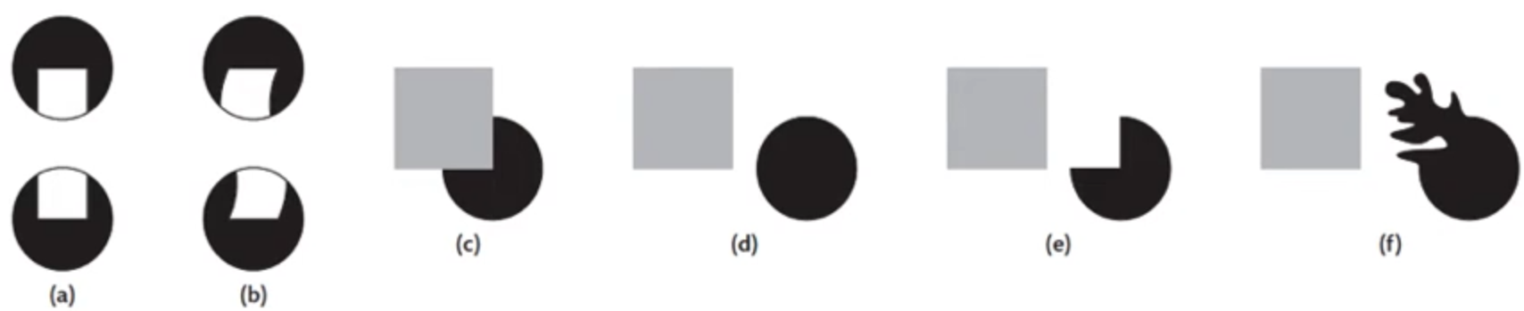
Perceptual grouping: interpolation
Two mechanisms at play:
Finding edges
Completing surfaces

Slide 75
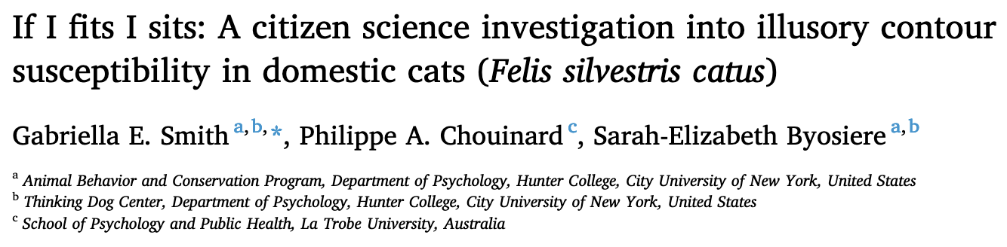
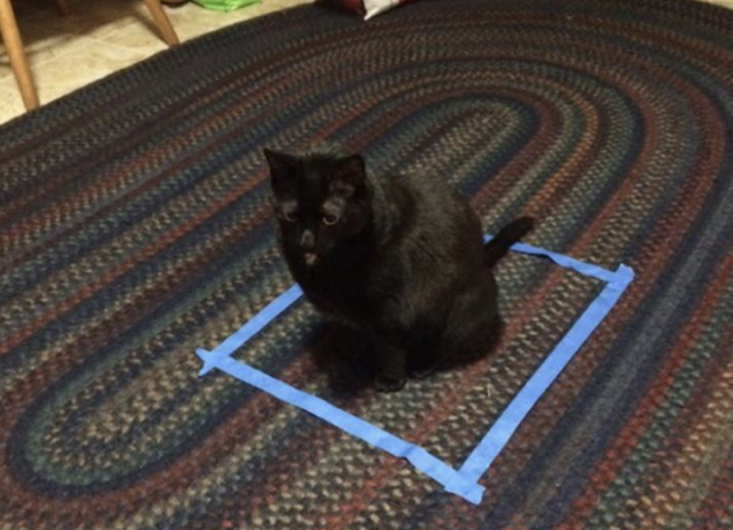
Perceptual grouping: interpolation
Cats do it too??

Slide 76
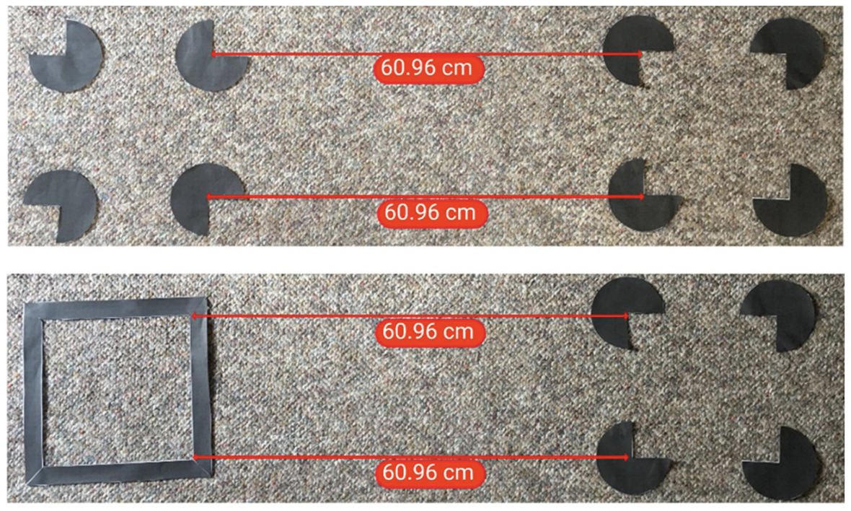
Perceptual grouping: interpolation
Cats do it too??

Slide 77
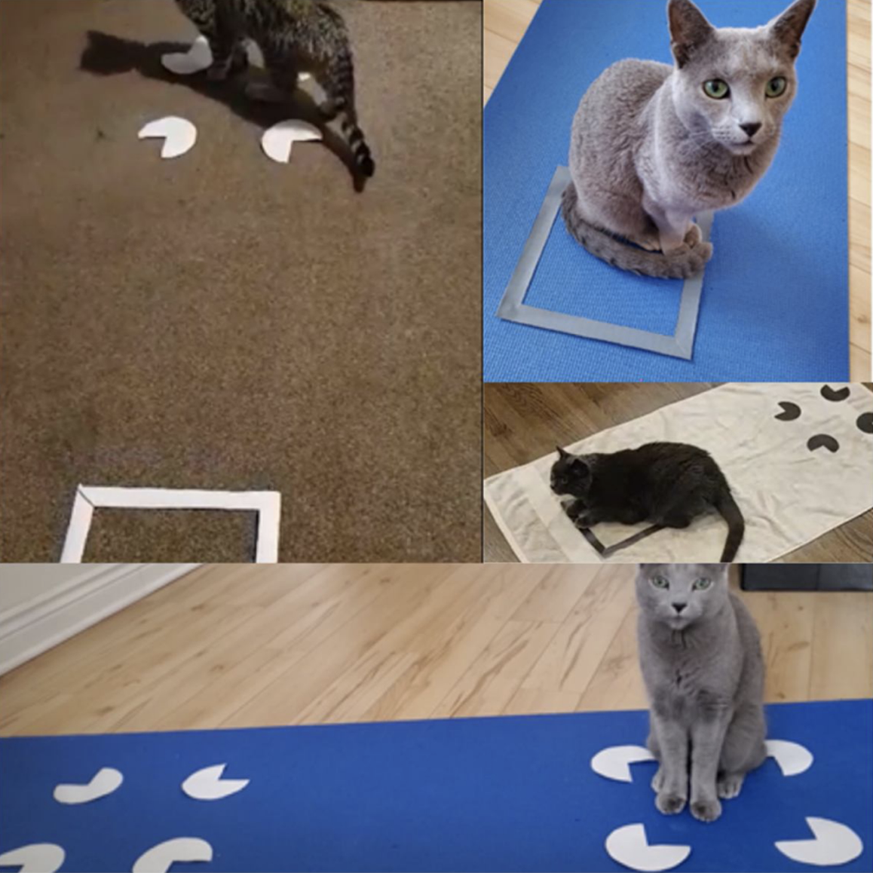
Perceptual grouping: interpolation
Cats do it too??

Slide 78

Perceptual grouping: interpolation
Cats do it too??

Slide 79

Perceptual grouping: why?
Natural statistics and constraints of the real world
If we can see our surroundings optimally, we have higher chances of survival
Perceptual grouping tends to work poorly for man-made stimuli
Magic tricks!
Illusions in the natural world are less common

Slide 80
Perceptual grouping: why?
Natural statistics and constraints of the real world
If we can see our surroundings optimally, we have higher chances of survival
Perceptual grouping tends to work poorly for man-made stimuli
Magic tricks!
Illusions in the natural world are less common
Implication: cultural background matters for your visualizations!

Slide 81
Saliency, attention, and perception for action
Once the brain processes the stimuli and assigns it meaning, we need to do some action in response to this perception
For this class, that mostly involves visually scanning or manipulating (interacting with) the visualization for new information
Our actions depend on which things we perceived
What did we pay attention to? What was most salient?

Slide 82

Preattentive processing
Some visual features make some elements/objects more easily seen

Slide 83
Preattentive processing
Some visual features make some elements/objects more easily seen
Find the ‘T’ symbol

Slide 84

Preattentive processing
Some visual features make some elements/objects more easily seen

Slide 85

Preattentive processing
Some visual features make some elements/objects more easily seen

Slide 86
Preattentive processing
Some features are more easily seen than others
Very complicated topic, no concrete explanation yet
Low-level features seem to be processed first
Color: hue, brightness, saturation, etc.
Edges, contours, angles, etc.
Contrast
Orientation
Motion
Spatial frequency
Put simply, these features contribute to the saliency of a visual element
Rule of thumb: salient elements are usually statistical outliers compared to nearby elements

Slide 87
Actions
Visual features have been processed, now we need to do something
Scan for new information
Manipulate (interact with) the visualization for new views

Slide 88

Actions: eye movements
Three types of eye movements:
Saccades: rapid, ballistic eye movements
Smooth pursuits: slow, smooth eye movements that allow us to maintain focus on a moving object
Vergence movements: allow the eyes to maintain their focus on objects at different distances from the observer
https://www.youtube.com/watch?v=u4U3ms8kmAY
Users will do these eye movements to gather new information in your visualizations

Slide 89
Attention and awareness
Just because something is in the field of view does not mean the observer is aware of it
Some things are very easy to perceive quickly, and some things are not

Slide 90
Scene gist
https://youtu.be/v4qx2OqfosU?t=160
80% accuracy with only 36 milliseconds of viewing

Slide 91

Scene gist

Slide 92
Attention blindness
https://www.youtube.com/watch?v=vJG698U2Mvo

Slide 93
Change blindness
https://www.youtube.com/watch?v=FWSxSQsspiQ

Slide 94

Attention blindness

Slide 95
TODO
TODO

